Slide 1
Healthcare analysis
GROUP 2
SHRUTI JITRI
RAHUL KUMAR R
PREETHU G R
MOHAMMED YASEEN

Slide 2
Summary of Kpis
The dashboard includes several important KPIs to monitor hospital performance:
• Total Patients Shows the total number of patients recorded in the dataset.
• Total Doctors Available Represents the number of doctors working across different specialties.
• Total Visits Indicates the total number of patient visits to the hospital.
• Total Lab Tests Conducted Shows the total number of diagnostic tests performed.

Slide 3
Summary of kpis
Total Patients Shows the total number of patients recorded in the dataset.
Total Doctors Available Represents the number of doctors working across different specialties.
Total Visits Indicates the total number of patient visits to the hospital.
Total Lab Tests Conducted Shows the total number of diagnostic tests performed.
Average Treatment Cost Displays the average cost incurred per treatment.
Total Revenue Represents the overall revenue generated from treatments and hospital services.
Average Age of Patients Shows the average age of patients visiting the hospital.
Follow-Up Rate Indicates the percentage of patients requiring follow-up visits.
Abnormal Test Result Percentage Shows the proportion of lab results that are abnormal.

Slide 4
Key insights
Common Health Conditions Migraine, Hypertension, Asthma, and Diabetes are among the most frequent diagnoses.
Patient Demographics The dashboard helps understand gender distribution and average patient age.
Regional Patient Trends Some states show higher patient counts, indicating higher healthcare demand.
Doctor Workload Certain doctors manage more patients, highlighting potential workload imbalance.
Revenue Insights Treatment types contribute differently to hospital revenue, helping identify high-value services.

Slide 5
conclusion
This healthcare dashboard helps hospitals:
Monitor patient activity and hospital performance
Identify common diseases and patient trends
Track treatment costs and revenue
Improve resource allocation and healthcare planning
Overall, the dashboard provides data-driven insights that support better healthcare management and decision-making.

Slide 6
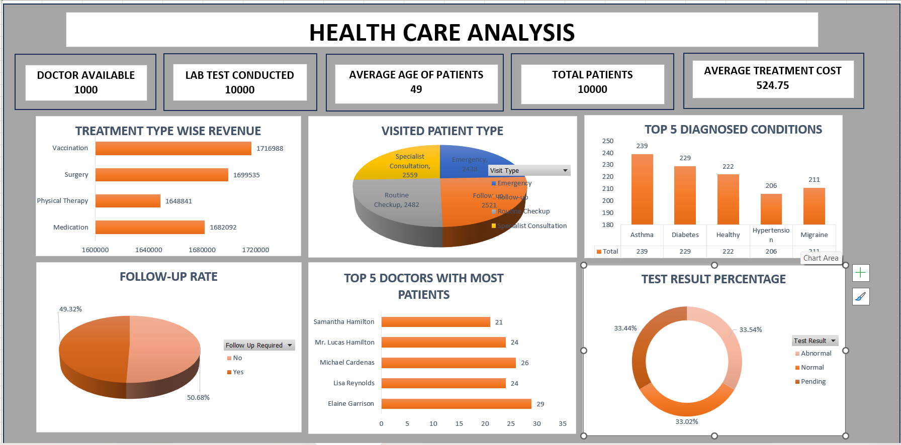
Excel dashboard

Slide 7
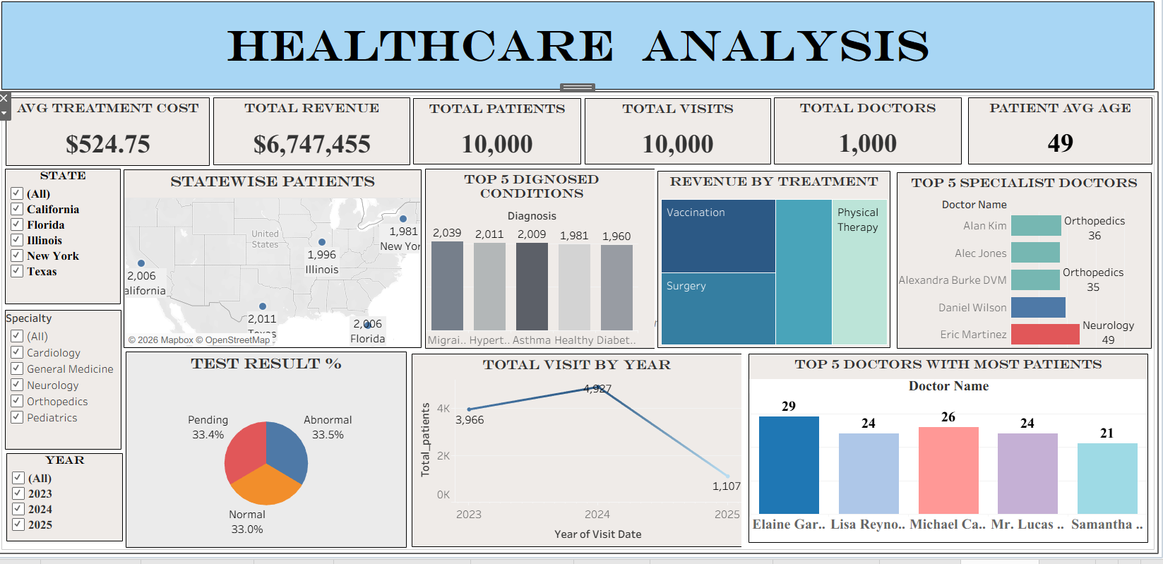
Tableau dashboard

Slide 8
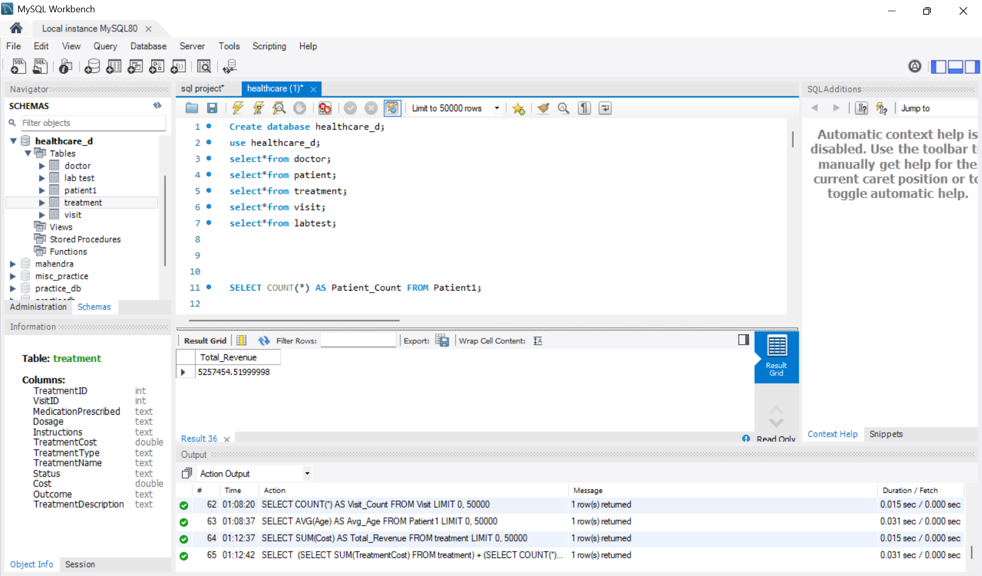
Sql

Slide 9
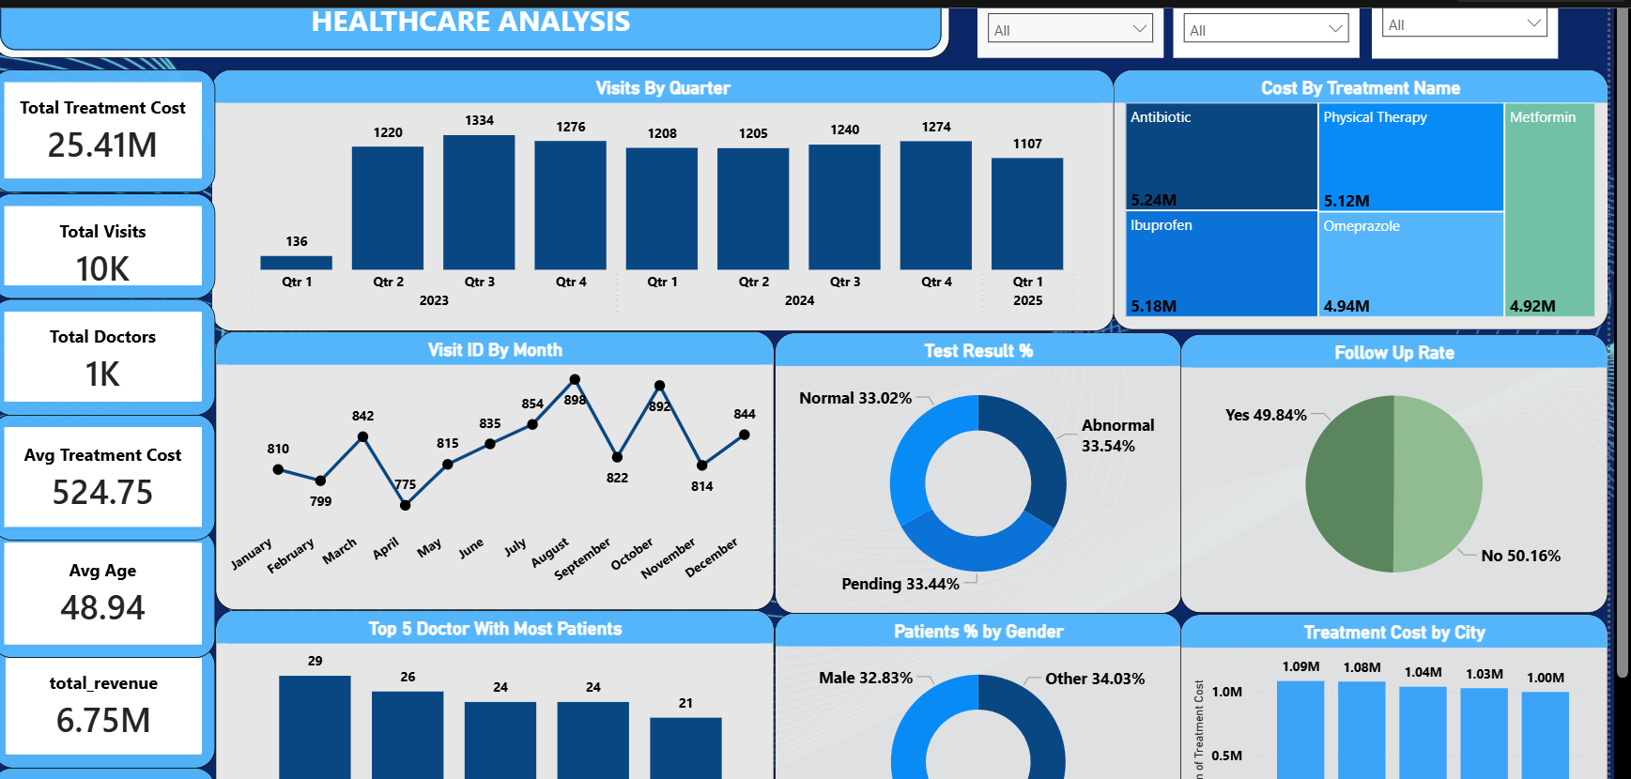
Power bi dashboard

Slide 10
Thank you

